Slide 1


Slide 2
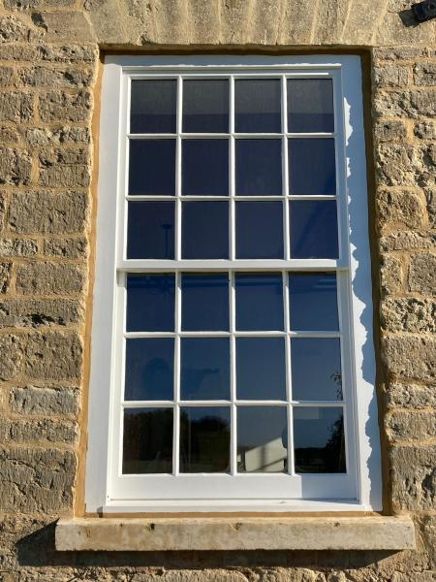
Edinburgh Windows and Doors are a leading manufacturer of Wooden windows & Doors
We began our journey in 2019, when refurbishing sash and case windows evolved into manufacturing the highest quality sash and case windows and timber doors
We have put ourselves in a niche, meaning we specialise in the manufacture of timber sash and case windows.
why we are the best choice
Take the worry out of your projects with a proven sash and case supply partner.
Commercial choice for construction companies, we work with Q -mile Developments, Ogilvie Construction, SJS, Cedar developments and many more.
We have proven ourself on large scale projects
Fraser Suites Edinburgh 156 windows restored / replaced
Craighouse restorations 136 windows restored / replaced
We can provide 6 – 8 week lead time on timber sash and case window supply only projects.

Slide 3
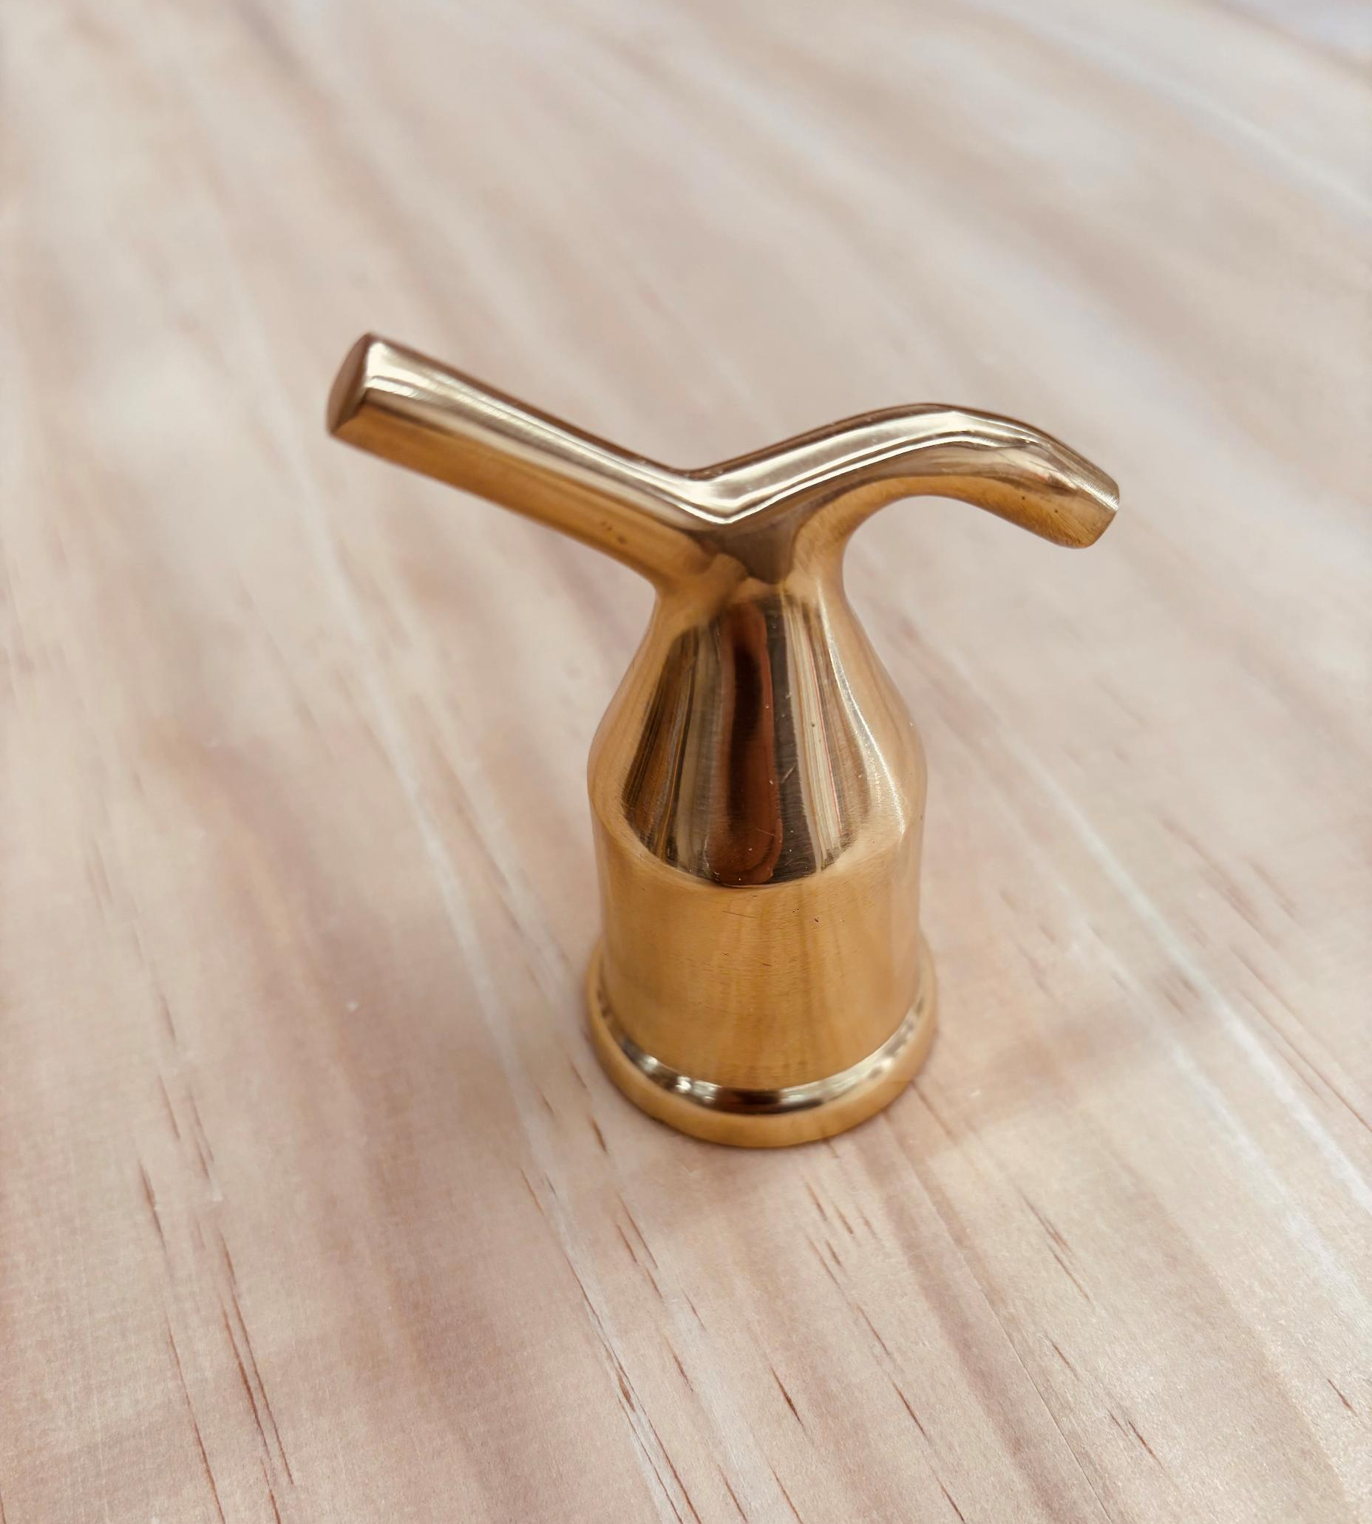
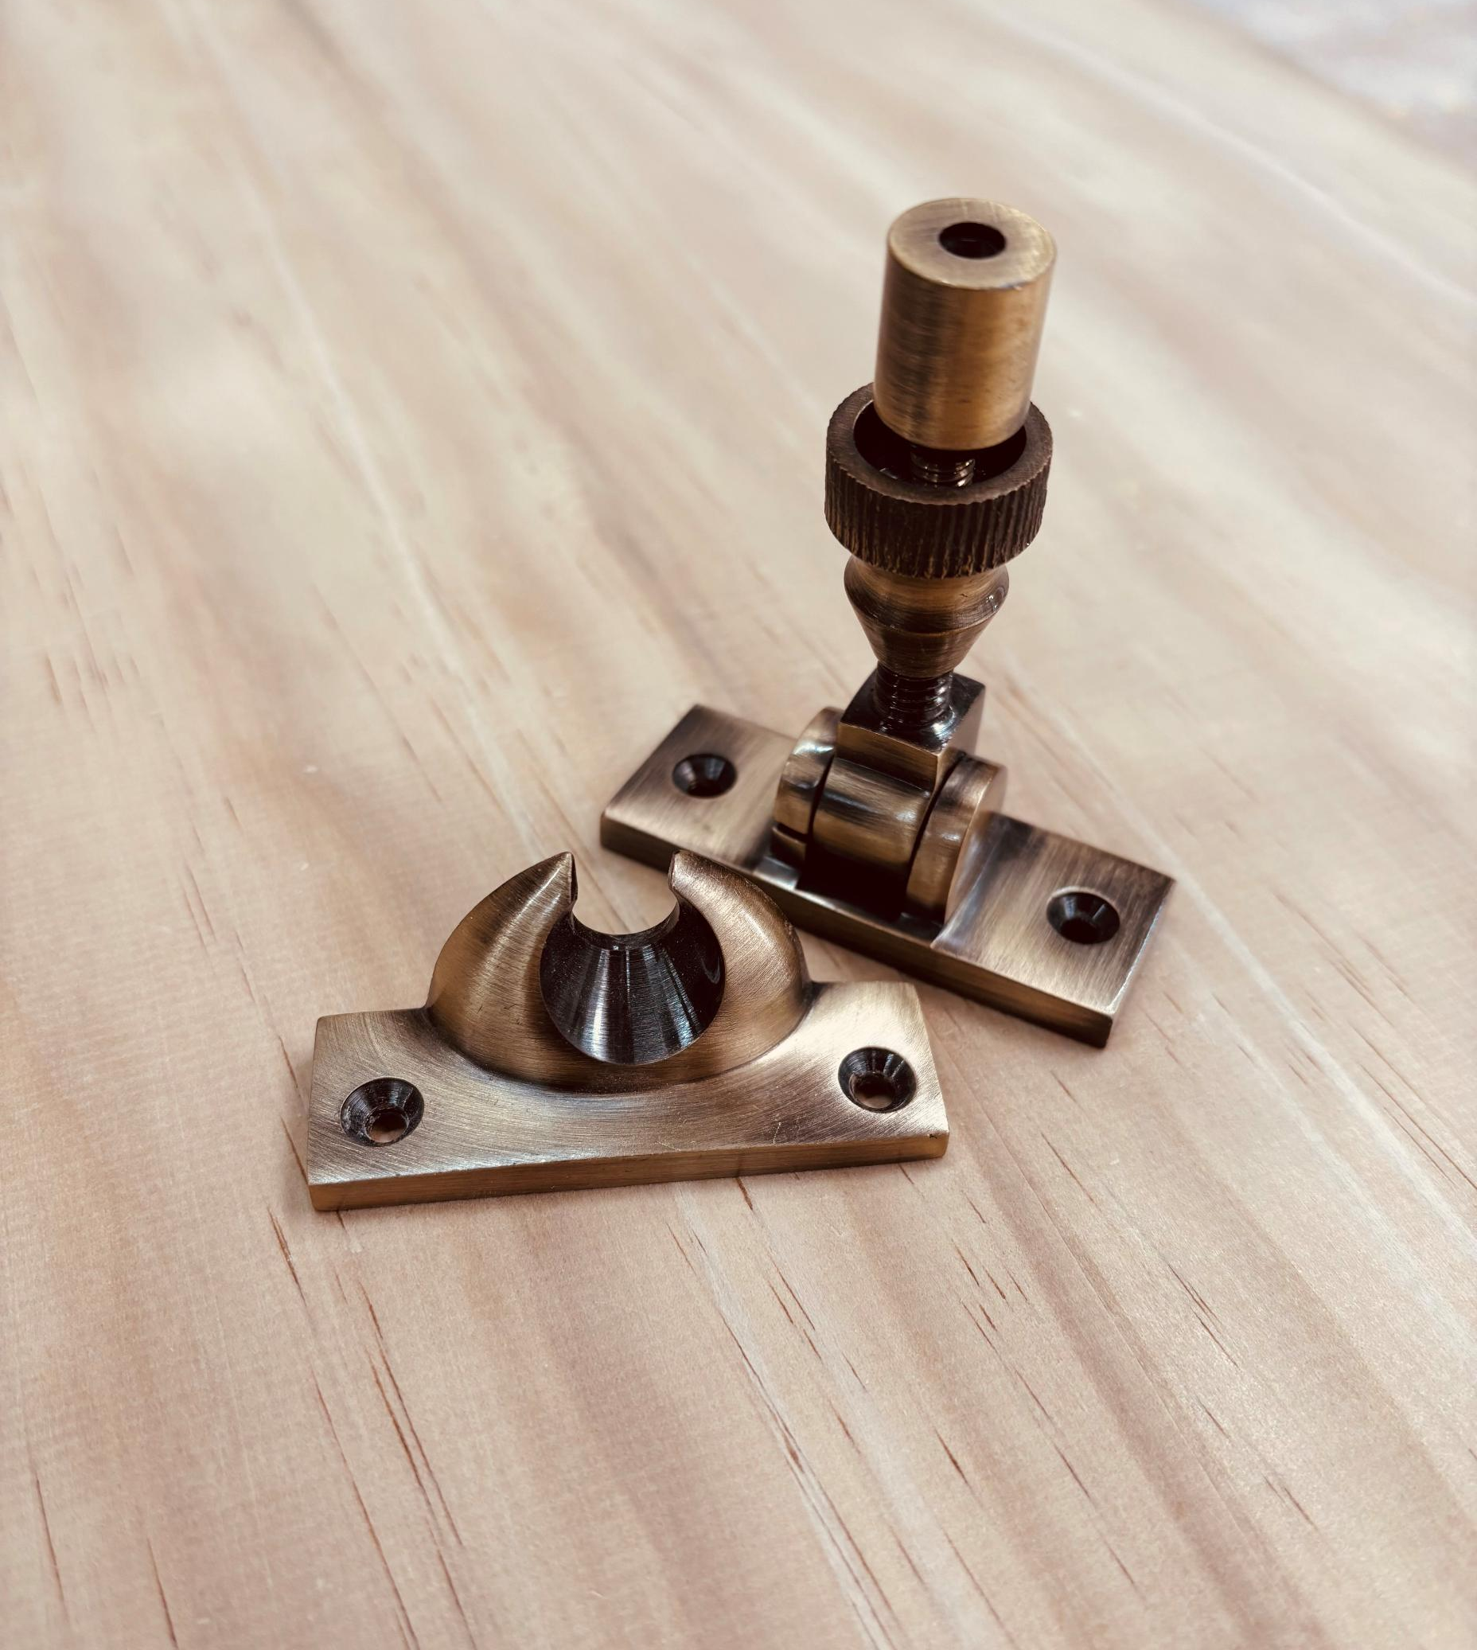
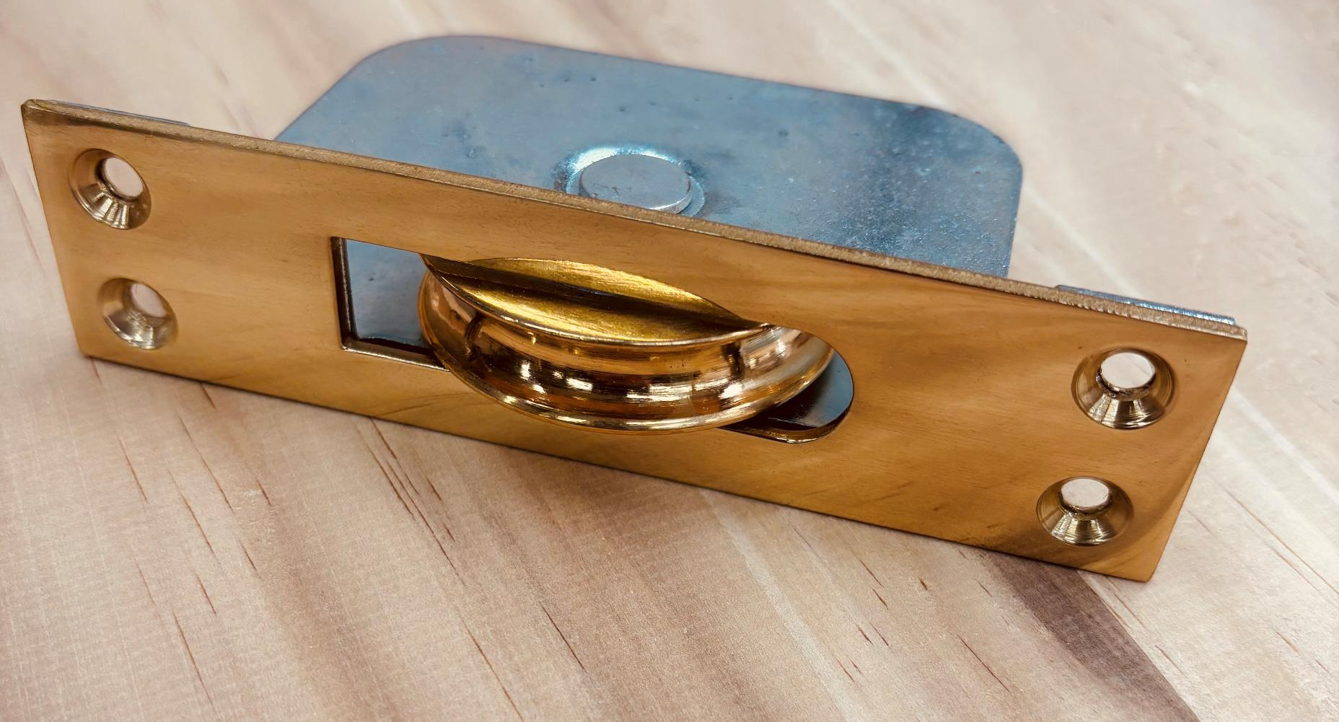
Traditional sash Ironmongery
We select our ironmongery for its superior quality. There are a number of different finishes available from Polished brass, Antique brass and even black.
Ironmongery selections are available for
Pulleys
Sash fastners
Ring pulls
Sash lifts
Simplex systems
Many more selections are available

Slide 4
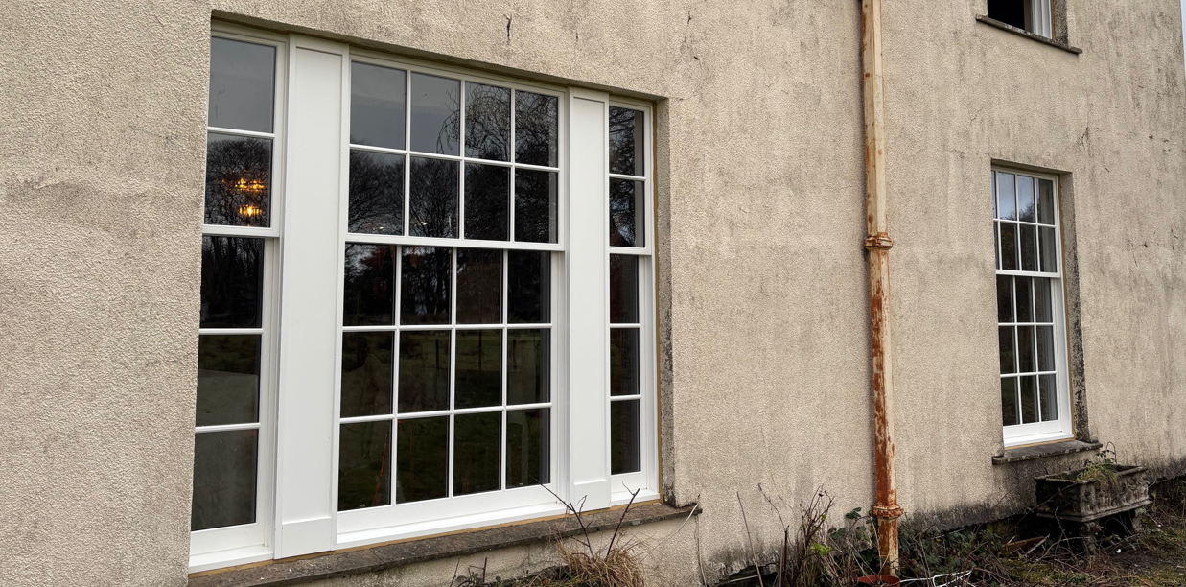
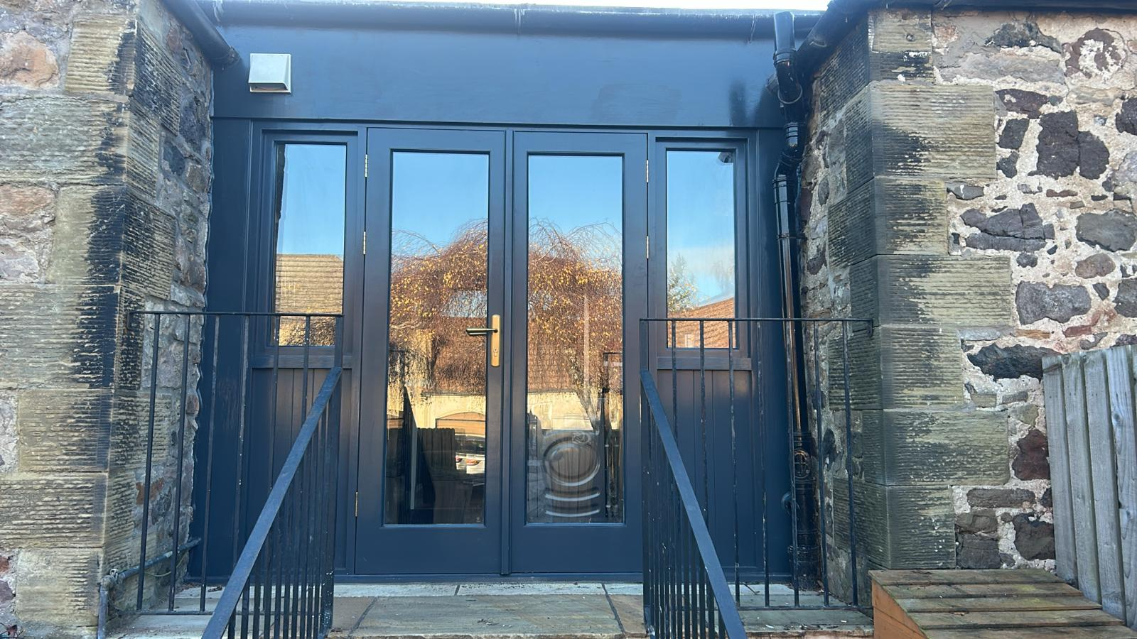
BESPOKE MADE TO MEASURE TIMBER
SASH AND CASE WINDOWS & ACCOYA DOORS
We work alongside Architects and building professionals as well as bespoke solutions tailored to homeowners. We combine expertise in sash and case window manufacture with a top - class service to exceed the requirements of all types of projects.
Sash and case windows
Accoya Timber Doors
Supply only direct to trade timber sash and case windows or Accoya Timber Doors
with large order capacity and UK wide delivery
Contact out trade team
sales@edinburghwindowsanddoors.co.uk
01506 168 204

